Slide 1
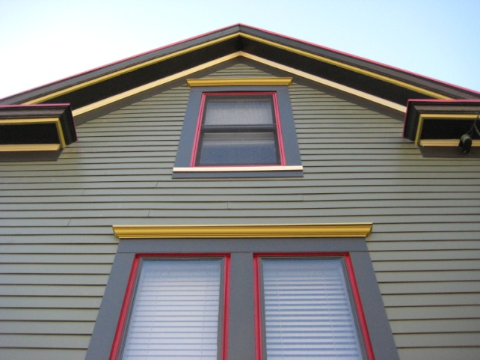
K-C Nietch Historic Renovation/Addition: An innovative and sustainable upgrade in the Columbia-Tusculum Historic District
Presented By: Christopher and Kimberly Nietch

Slide 2
Nietch Vision
Use 511 Tusculum as a platform for accomplishing our personal and professional goals of a more sustainable lifestyle.
Conduct a sustainable rehab and addition plan. Attempt to achieve a net zero energy consumptive difference before and after.

Slide 3
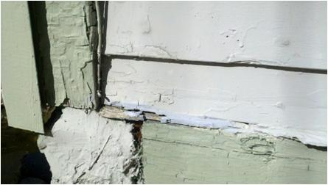
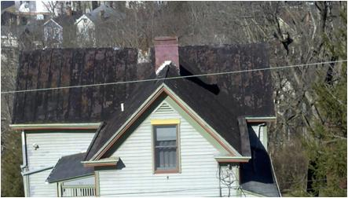
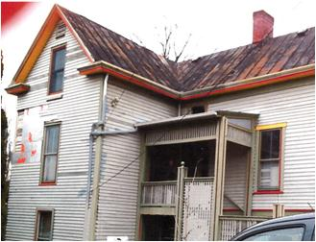
What Had To Be Done?
Replace roof
Repair box gutters
Replace siding and trim and paint
Re-insulate and seal
Correct foundation issues
Dry-rot, old cedar siding
Replace Aluminum Siding
Non-repairable old metal roof

Slide 4
What Was Done?
Replaced roof with new metal, w/ Kynar 500; best coating for rain harvesting
Repair box gutters, added coarse particle filtration
Corrected foundation issues, added shoring piers
Replaced decks w/ new lower and 2nd fl. addition and roof terrace
Used fiber cement siding/trim and Azek/Fypon architectural features
Reinsulated (spray-in foam, cellulose, Tyvec wrap)
Replaced all casement windows with double hung
Replaced overloaded floor joists, re-finished and re-used as interior trim.
Added full-scale rain harvest system
Replaced one gas furnace with high efficiency, zonal heat pump system
Added solar thermal system for hydronic radiant heating and domestic hot water.
Added solar electric system to offset added electric demand of new additions.
Aluminum stairs and rails added
Replaced skylight with Energy Star Upgrade
Added studio therapy room with sauna and steam room.

Slide 5
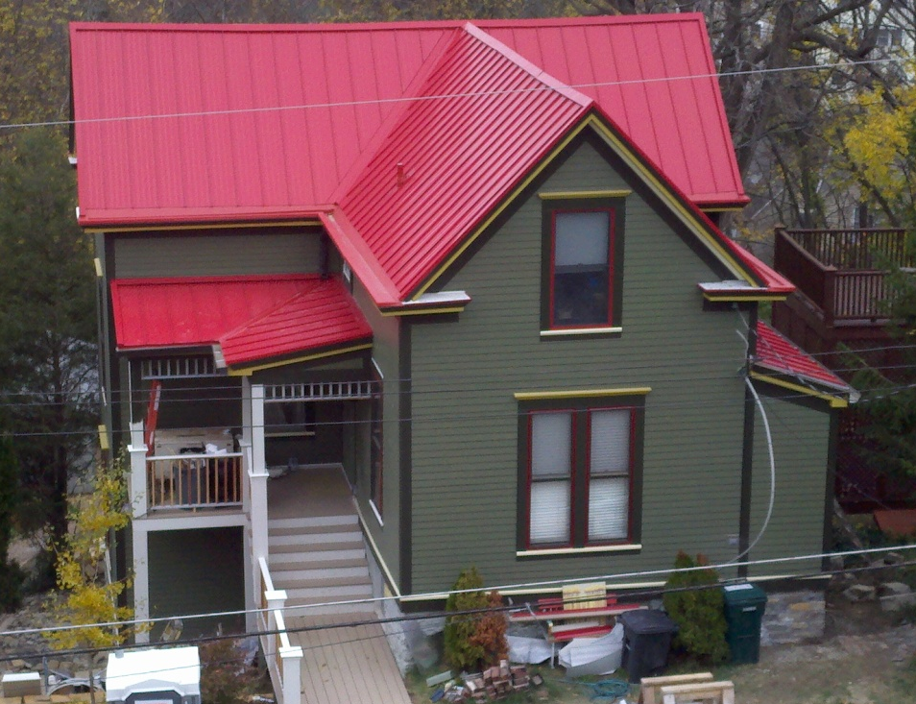
Before and After - Front
Builder: Tony Beck, Andeck Building Inc. dba GreenBau

Slide 6
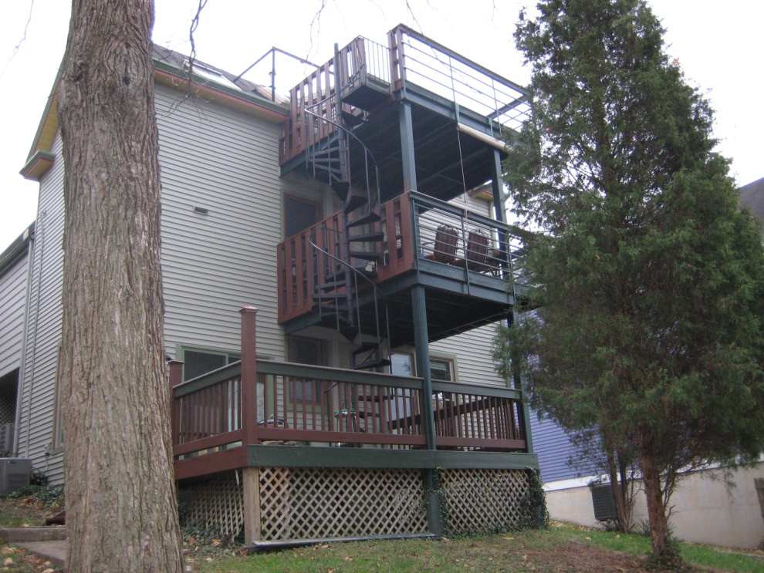
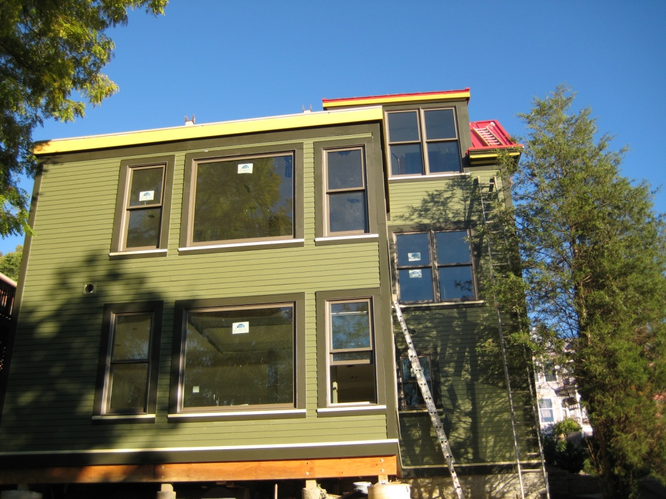
Before and After - Rear

Slide 7
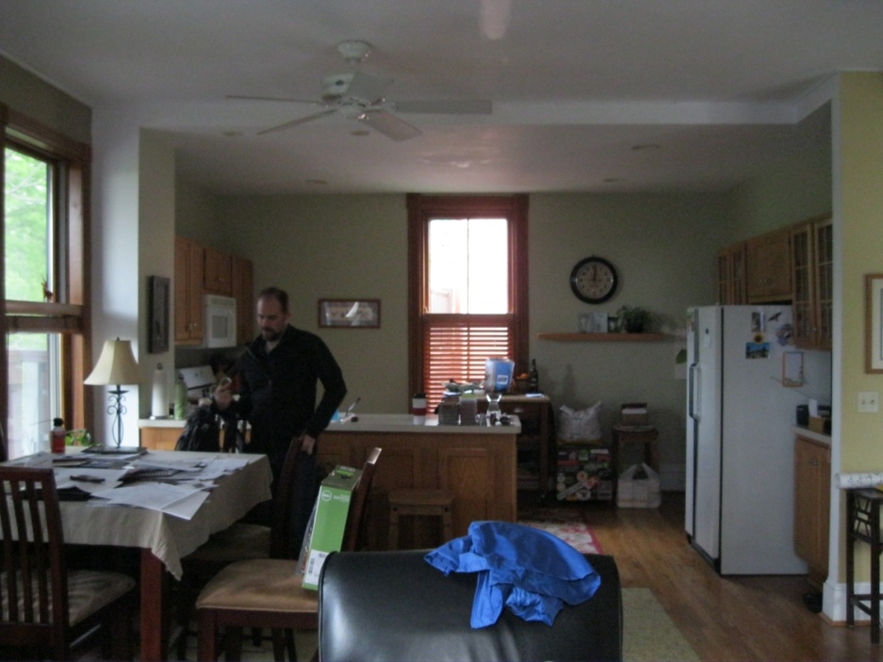
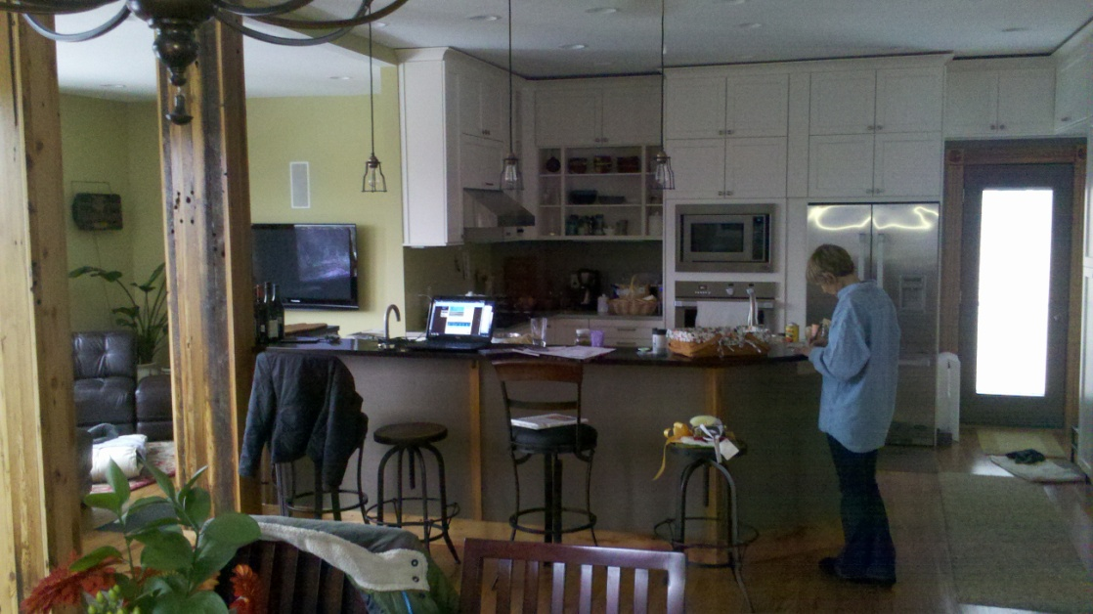
Before and After – Kitchen/Dining

Slide 8
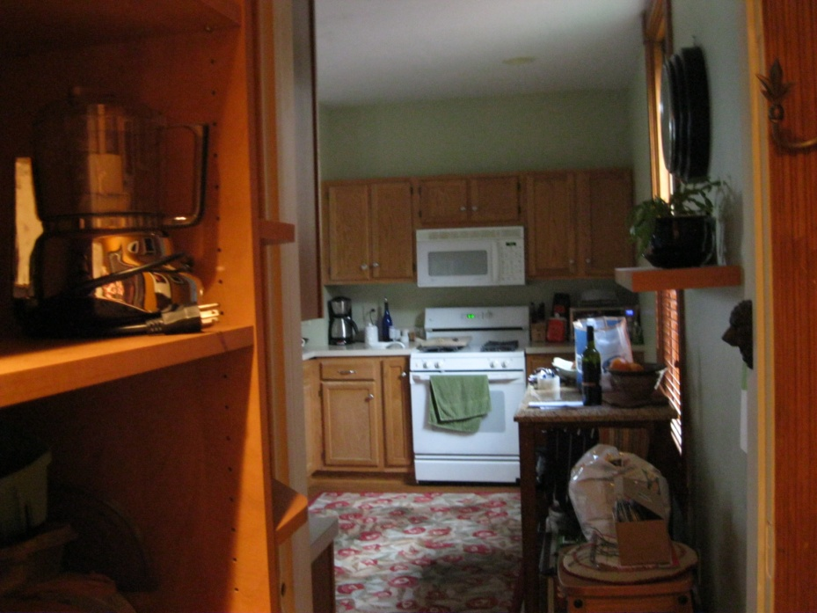
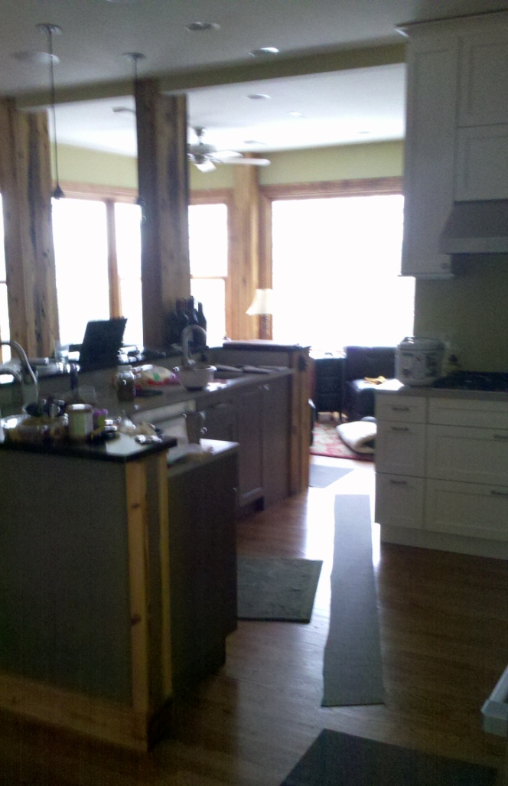
Before and After – Kitchen

Slide 9
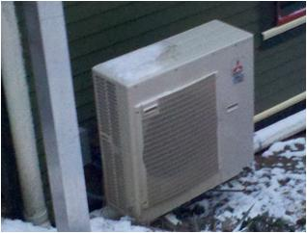
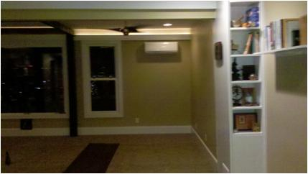
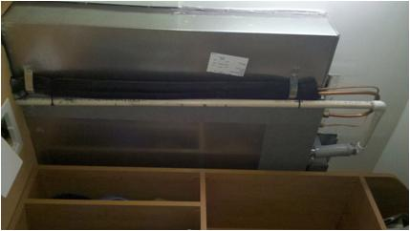
High Efficiency Heating and Cooling
Mitsubishi Zonal Heat Pump (Mr. Slim). 3 ton capacity for total cooling load for new lower addition, supplemental heating for studio, and replacement for upstairs furnace.
$2,500.00 incentive grant from Greater Cincinnati Energy Alliance.
It's a split system heat pump, which means that the compressor and condensing coil are outdoors, and the evaporator coil and blower are indoors.
Ideal for zoning a house, limits the amount of energy used for heating and cooling.
Mr. Slim heat pump outdoor unit
Wall-mount mini-split in studio
Ceiling-mount mini-split replaced furnace upstairs

Slide 10
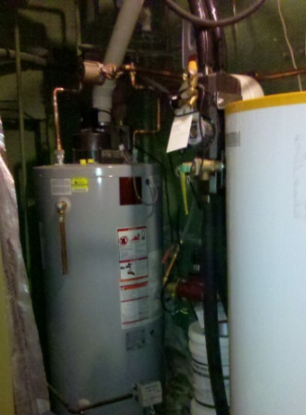
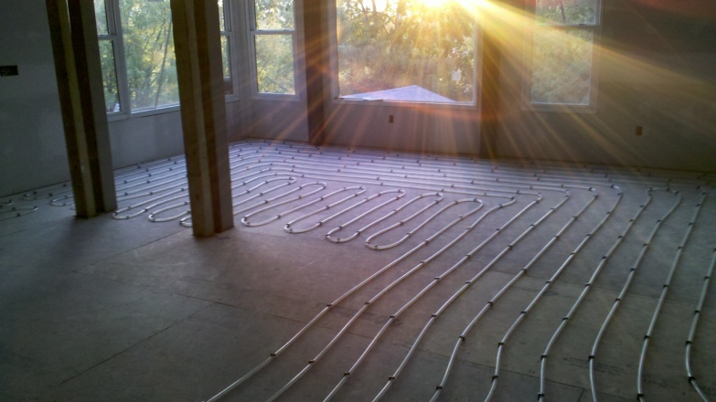
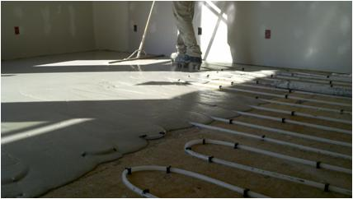
Solar Thermal Water Heating System
Collectors positioned on dormer of master bedroom
Provides radiant floor heating for studio and an estimated 80% annual average domestic hot water needs
Size | 50,000 btu
Output/day | 78.4 kbtu (thousand btu’s)
Type | Closed loop, glycol system
Heating offset | Approx. 80% of total household
System incentives first year | $2,352.00 Green Energy Ohio Grant $1,000.00 GCEA $5,902.20 Federal tax Credit
Hot water tank and solar exchange tank
Hydronic radiant floor tubing being installed in studio

Slide 11
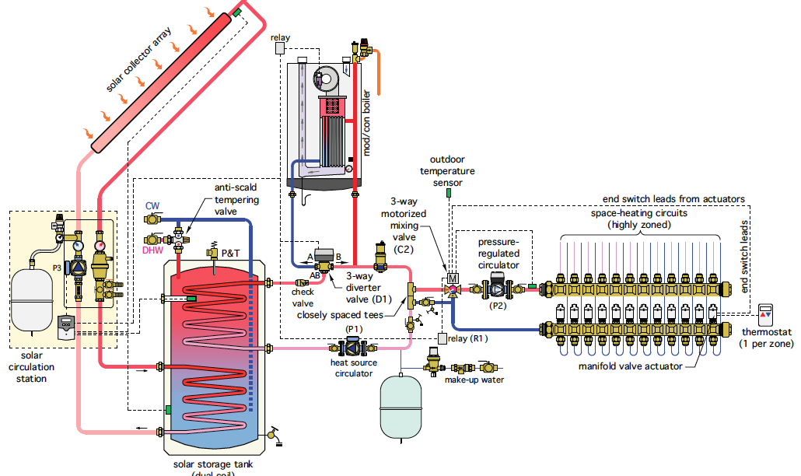
Caleffi Solar Thermal Heating System Schematic

Slide 12
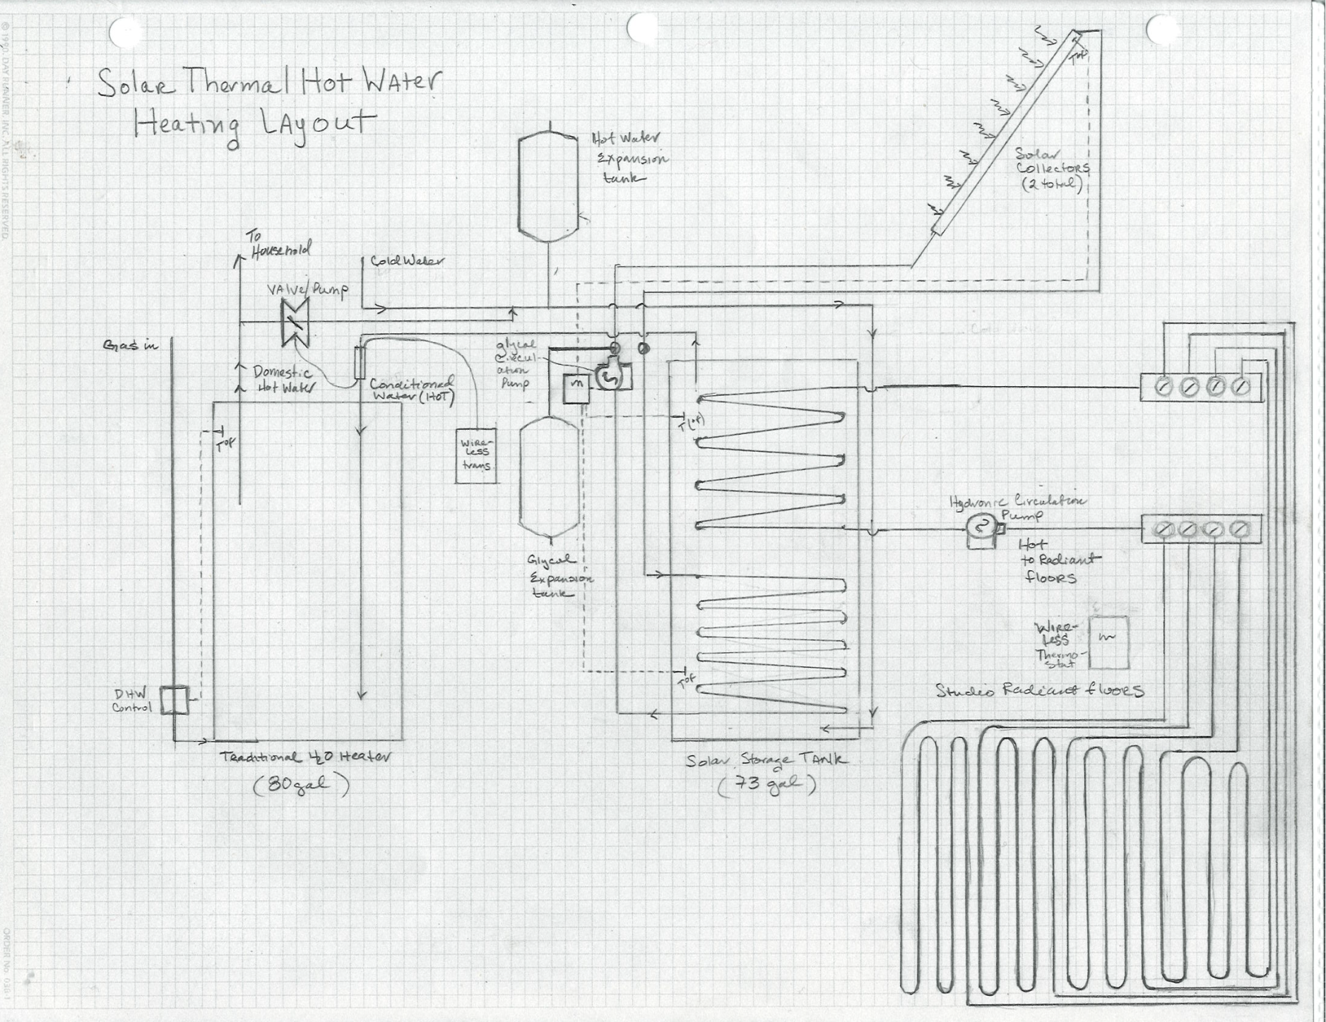
Actual Layout of Solar Thermal System

Slide 13
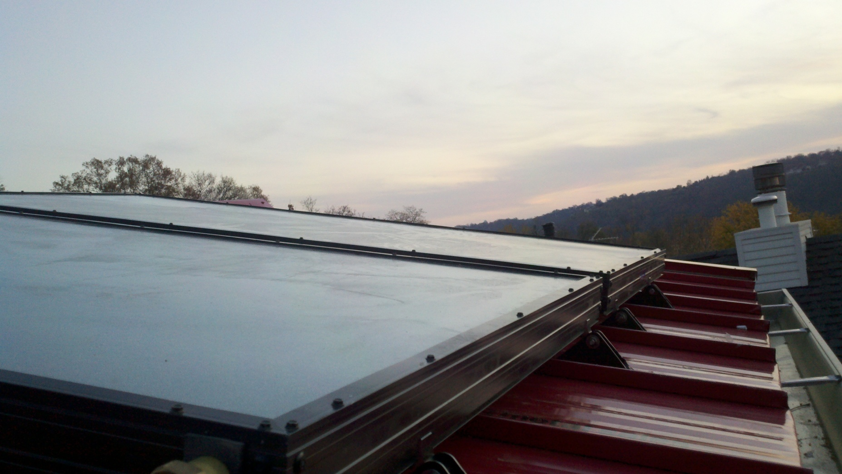
Solar Thermal Collectors

Slide 14
Solar Pergola Design Considerations
Solar, photovoltaic, with un-shaded southern exposure is critical feature for achieving net zero goal.
Best mounting location is area of roof visible from street. But historic guidelines say to avoid utilities on this roof surface.
Back terrace has southern exposure and we could use shade option.
Pergolas are historic, and would be good option for both shade and mounting solar panels.
Pergola shall not be constructed higher than the existing roof line
Solar panels on back of structure will only be visible by neighbor to the immediate South. They and neighbors on the other side support our effort

Slide 15
Solar Electric System
Size | 2940 w (watts)
Output/Year | 3,300 kWh (kilowatt hours)
Type | Grid tied
Electrical offset | Approx. 33% of total household load
System incentives first year | $5, 763.00 federal $429.00 Duke offset $400.00 SREC sold

Slide 16
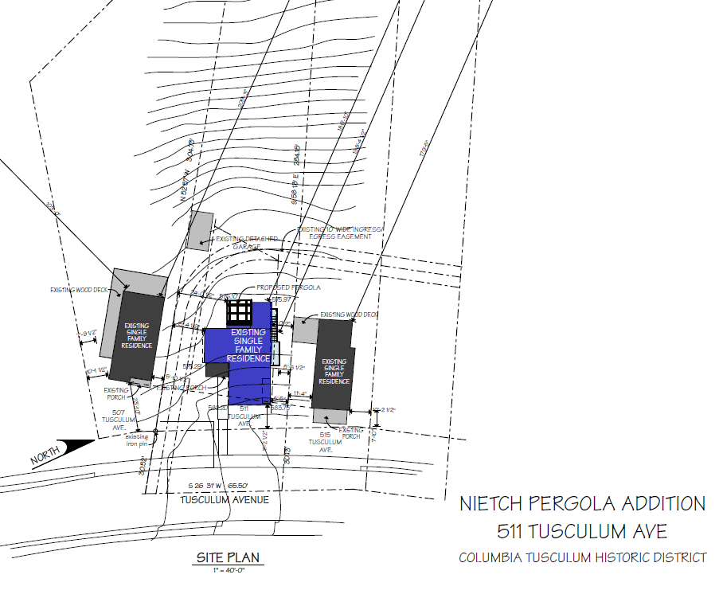
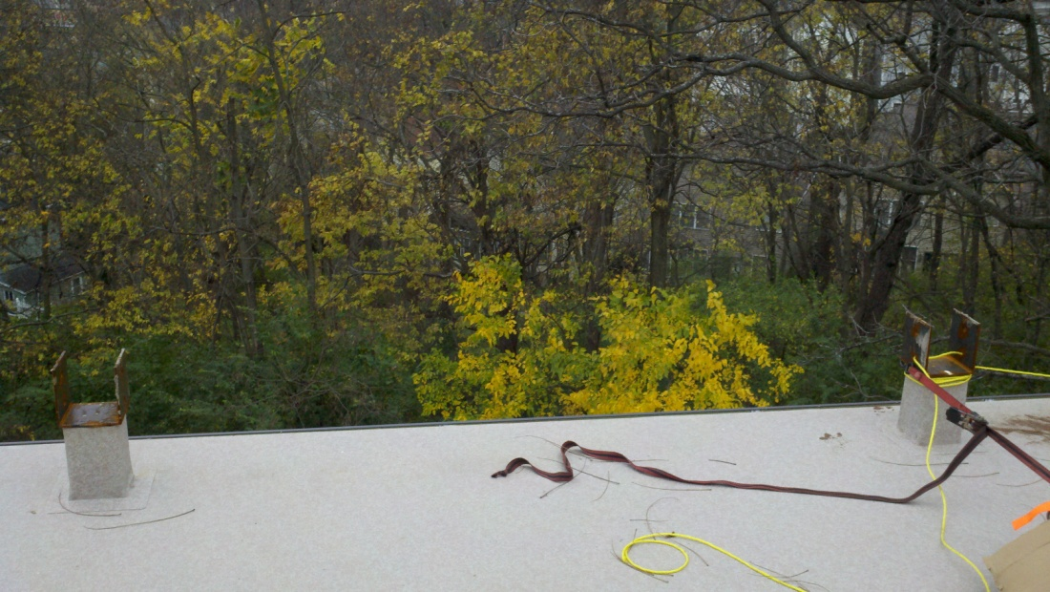
View from back terrace
Steel supports were added in preparation for the pergola on the terrace to keep the overall project on track

Slide 17
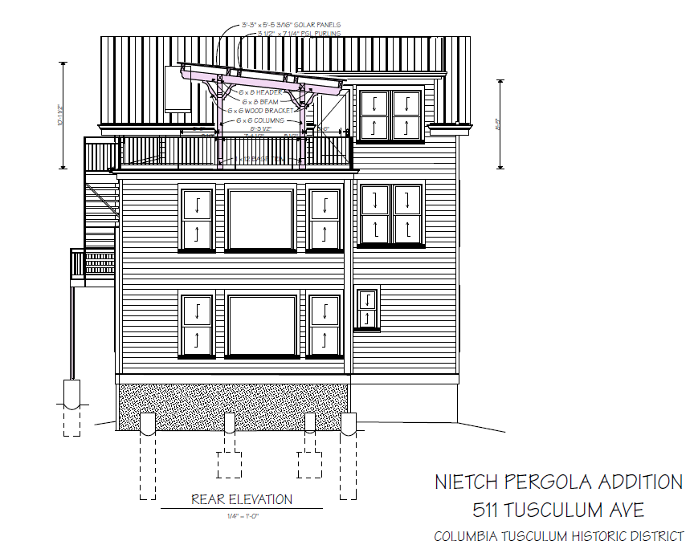
West Elevation – Back of House

Slide 18
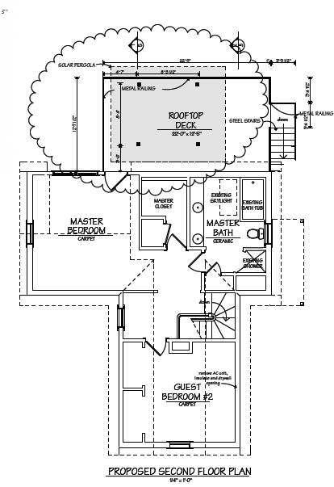
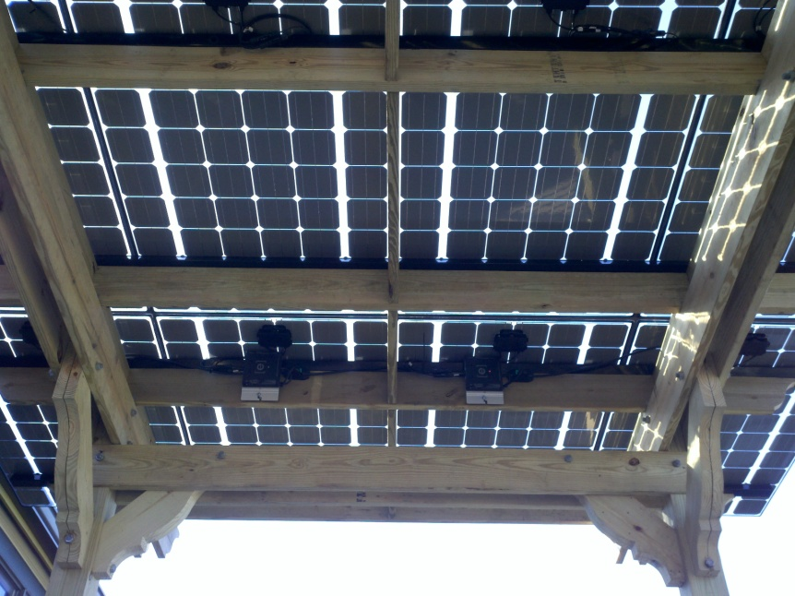
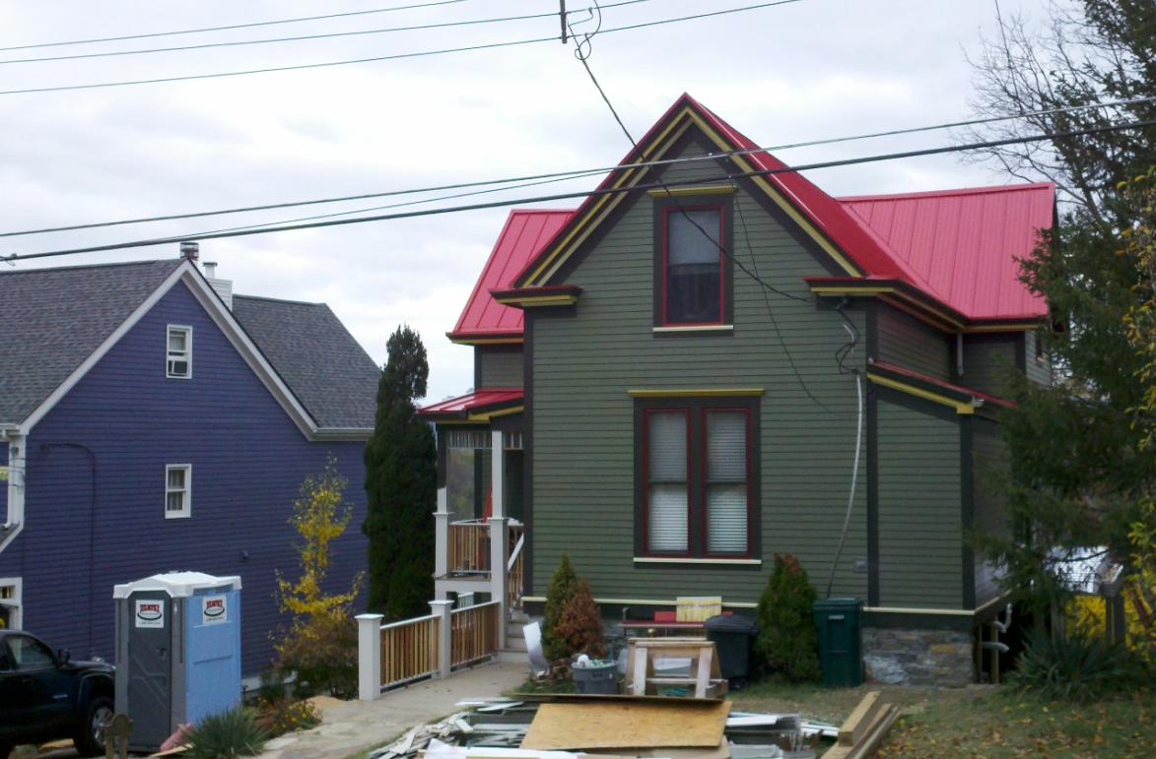
Pergola’s solar panels will be slightly sloped and see-through, wood supports will be painted to match house
Street view looking southwest. Pergola will not go above existing roof line. And will be out of view from across-the-street painted ladies

Slide 19
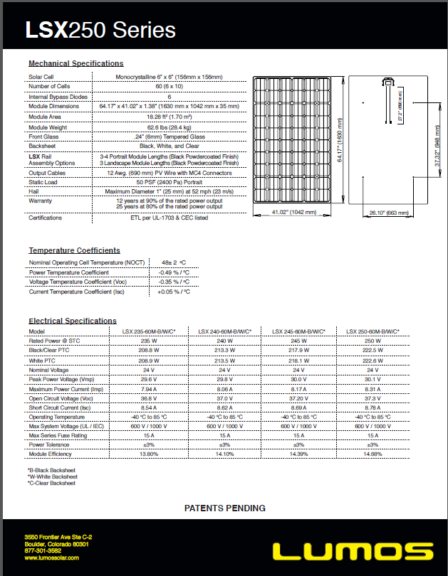
Lumos solar panels are state-of-the-practice

Slide 20
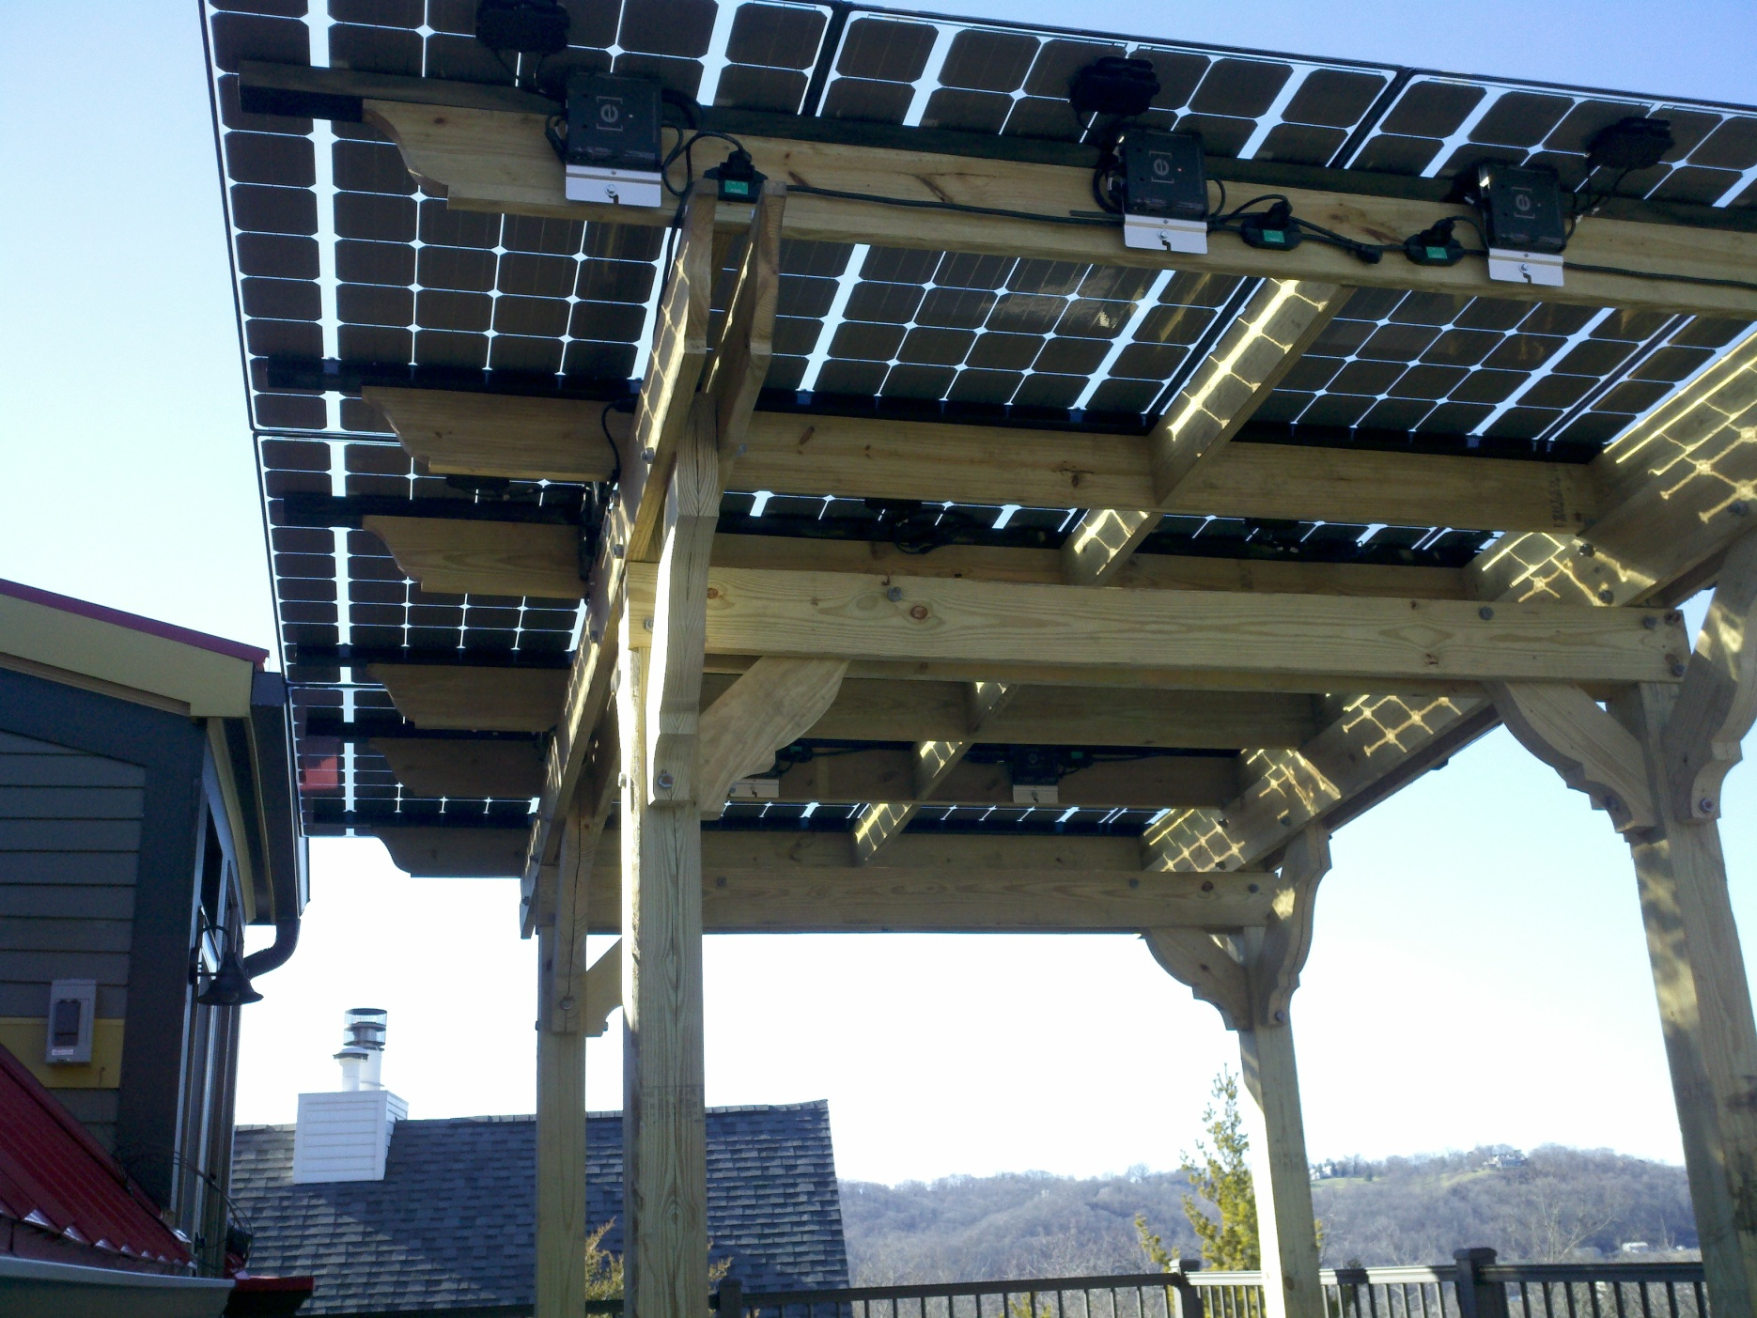
Finished Solar Pergola

Slide 21
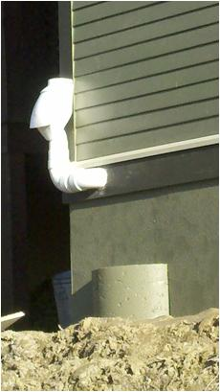
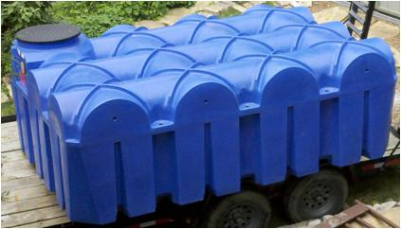
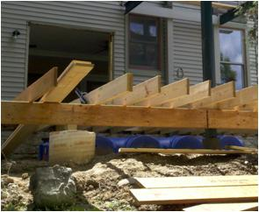
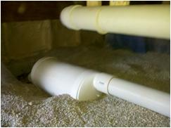
Rain Harvest System
Design meets total demand of 2250 gallons per month
Clean roofing, first flush diversion, particle filtration, non-potable supply lines, mains topoff, and overflow to combined sewer had to be built into the design
Design criteria for the main storage tank included freeze protection, non-burial, and hillside overlay.
Leaf Eater Downspout Filters
Rain tank under new addition
Roof washer in crawl

Slide 22
Rain Harvest System Schematic

Slide 23
“Green Approved” Practices
Azek, cellulose PVC,decking and trim
DecTec membrane on rooftop terrace plus cool roof rating
Atas Metal Roofing/Cool Roof Rating, PFOA safe
James Hardie fiber cement siding and trim
DuPont’s Tyvek weatherization system
AdvanTech Advantage subfloors
Velux Residential Sky lighting
Quaker windows meeting Energy Star criteria
Wet cell spray cellulose insulation
All caulks, glues, epoxies, and resins used
Aya kitchen cabinetry
Caesar stone, crushed quartz countertops
Chilewich’s Plynyl, Green Label Plus
Recycled Rubber flooring underlayment
Porcelain wood grain tile
Kohler low flush toilet
Low flow vanity, sinks, and shower fixtures
80% recycled cast iron sinks

Slide 24
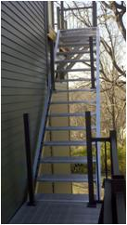
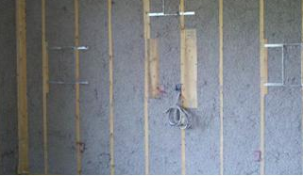
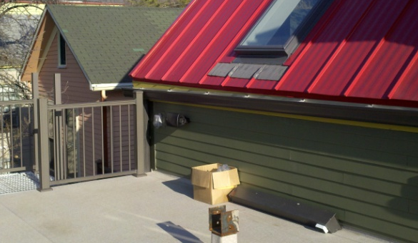
Acknowledgments
Tom Warner, Architect
Tony Beck, Builder
EcoEnvironments, Alternative Energy Systems
Ben Haggerty, Rain Tank
Greener Stock, Sustainable Interiors
Cooknee, Green Kitchen Cabinetry
Aluminum stairs
Velux skylight
Wet cell spray
cellulose insulation

Slide 25
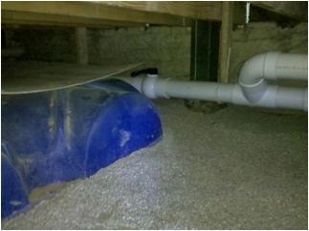
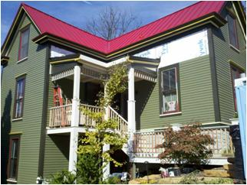
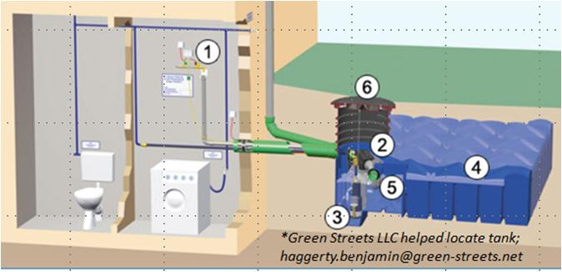
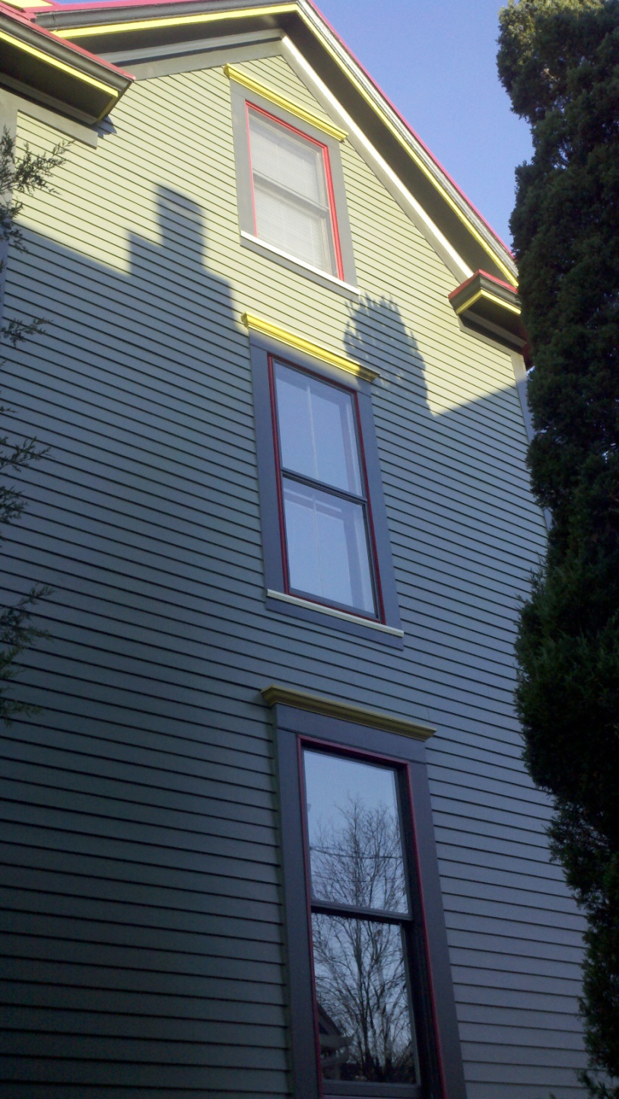
Solar Electric System
Solar electric panels could not be placed on the south facing roof surface because of historic district guidelines
Designed a pergola on the roof terrace to accommodate panels. Had to be approved by Historic Conservation Board
K-C Nietch Historic
Renovation/Addition:
An innovative and
sustainable upgrade in the
Columbia-Tusculum Historic District
Tank half buried in crawl
Schematic of rain harvest system
Size | 2940 w (watts)
Output/Year | 3,300 kWh (kilowatt hours)
Type | Grid tied
Electrical offset | Approx. 33% of total household load
System incentives first year | $5, 763.00 federal $ 429.00 Duke offset $ 400.00 SREC sold
“Green Approved” Practices
Azek, cellulose PVC,decking and trim
DecTec membrane on rooftop terrace plus cool roof rating
Atas Metal Roofing/Cool Roof Rating, PFOA safe
James Hardie fiber cement siding and trim
DuPont’s Tyvek weatherization system
AdvanTech Advantage subfloors
Velux Residential Sky lighting
Quaker windows meeting Energy Star criteria
Wet cell spray Cellulose Insulation
All caulks, glues, epoxies, and resins used
Aya kitchen cabinetry
Caesar stone, crushed quartz countertops
Chilewich’s Plynyl, Green Label Plus
Recycled Rubber flooring underlayment
Porcelain wood grain tile
Kohler low flush toilet
Low flow vanity, sinks, and shower fixtures
80% recycled cast iron sinks
Solar Pergola
Rain Harvest System
Design meets total demand of 2250 gallons per month. Pending Water Works approval
Clean roofing, first flush diversion, particle filtration, non-potable supply lines, mains topoff, and overflow to combined sewer had built into the design
Aluminum stairs
Design criteria for the main storage tank included freeze proofing, non-burial, and hillside overlay
Leaf Eater Downspout Filters
Acknowledgments: Tom Warner, Architect; Tony Beck, Builder; Eco-Environments, Alt. Energies; Ben Haggerty, Rain Tank; Greener Stock, Sustainable Interiors.
Rain tank under new addition
Wet cell spray
cellulose insulation
Velux skylight
Roof washer
in crawl

Slide 26
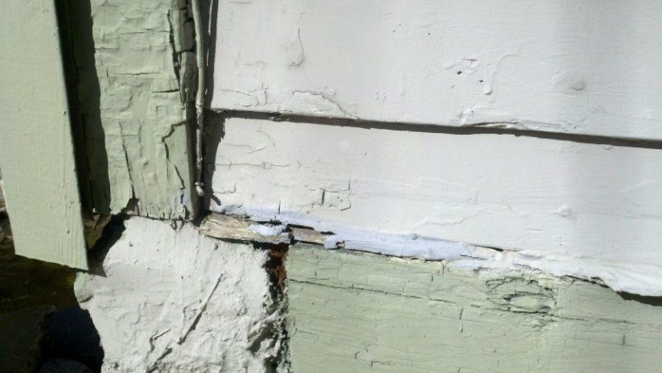
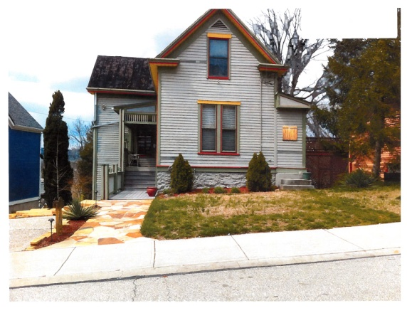
Before
After
Non-repairable old metal roof
Dry-rot, old cedar siding
Solar Thermal Water Heating System
Collectors positioned on dormer of master bedroom
Provides radiant floor heating for studio and an estimated 80% annual average domestic hot water needs
K-C Vision
Use 511 Tusculum as a platform for accomplishing our personal and professional goals of a more sustainable lifestyle.
Conduct a sustainable rehab and addition plan. Attempt to achieve a net zero energy consumptive difference before and after.
Size | 50,000 btu
Output/day | 78.4 kbtu (thousand btu’s)
Type | Closed loop, glycol system
Heating offset | Approx. 80% of total household
System incentives first year | $2,352.00 Green Energy Ohio Grant $1,000.00 GCEA $5,902.20 Federal tax Credit
What Had To Be Done
Replace Roof
Repair Box Gutters
Replace/Repair Siding and Trim and Paint
Re-insulate and Seal
Correct Foundation Issues
High Efficiency Heating and Cooling
Mitsubishi Zonal Heat Pump (Mr. Slim). Total cooling load for new lower addition, supplemental heating for studio, and replacement for upstairs furnace.
$2,500.00 incentive grant from Greater Cincinnati Energy Alliance.
It's a split system heat pump, which means that the compressor and condensing coil are outdoors, and the evaporator coil and blower are indoors.
What Was Done
Replaced roof with new metal, w/ Kynar 500; best coating for rain harvesting
Repair box gutters, added coarse particle filtration
Corrected foundation issues, added shoring piers
Replaced decks w/ new addition and roof terrace
Used fiber cement siding/trim and Azek/Fypon architectural features
Reinsulated (Spray-in foam, cellulose, Tyvec wrap)
Replaced all casement windows with double hung
Replaced overloaded floor joists levels, re-finished and re-used as interior trim.
Added full-scale rain harvest system
Replaced one gas furnace with high efficiency, zonal heat pump system
Added solar thermal system for hydronic radiant heating and domestic hot water.
Added solar electric system to offset added electric demand of new addition.
Aluminum stairs and rails added
Replace skylight with Energy Star Upgrade
Studio therapy room with sauna and steam room.
Caleffi Solar Thermal Heating System Schematic
Ideal for zoning a house, limits the amount of energy used for heating and cooling.
Mr. Slim heat pump outdoor unit
Ceiling-mount mini-split replaced furnace upstairs
Wall-mount mini-split in studio
Size | 3 ton
Type | Heat pump system
Heating and cooling offset | Total load for addition
System incentives first year | $2,500 GreaterCincy Energy Alliance
Hydronic radiant floor tubing being installed in studio
Hot water tank and solar exchange tank

